Slide 1


INVENTORY FULFILLMENT DATABASE MANAGEMENT SYSTEM HOTEL DRAGONFLY
Ian Ustanik and Rishabh agarwal

Slide 2
TABLE OF CONTENTS
Introduction
Current scenario
Proposed database system
Data questions
Entity relationship diagram
Demo slides
Conclusion

Slide 3
INTRODUCTION
The project focuses on designing an inventory fulfillment database management system for the hotel rooms in Hotel Dragonfly located in Mumbai.
The hotel has 30 rooms and 10 service apartments (apartments rented out for a longer duration by the employees of the corporate firms in the vicinity).
The hotel is located close to the international airport so it caters to both business as well as leisure travelers.
It provides hotel lodging, banquet halls for corporate and social events and restaurant services.
Hotels require a large amount of inventory for both guest rooms and other accommodations such as restaurants and banquet halls. This makes it crucial for any company within the hospitality industry to streamline their supply chain to ensure that there is enough inventory to provide excellent service to their customers.
It is privately owned, and stand-alone, so the inventory record keeping is not carried out by a large resource management software.

Slide 4
CURRENT SCENARIO
At present, the inventory of food supplies and other items such as toiletries, towels, etc. is managed manually by maintaining excel sheets and manual bookkeeping by the purchase manager.
This is insufficient and can lead to several different issues. This includes program-data dependence, duplication of data, limited data sharing, lengthy development times, and excessive program maintenance, among others.
When the inventory for the room supplies and the restaurant items reach a critical level, the purchase manager orders them by compiling a list of items required and then contacts the vendor for them to be replenished.
This happens when an inventory purchase is made that contains both order line and product. As a result, the hotel is in the process of entirely digitizing their operations.

Slide 5
PROPOSED DATABASE SYSTEM
In the proposed system, the customer’s details are entered at the time of making a reservation and allotted a room depending on the group size of the customer as the hotel has a policy where they allow a maximum of three guests in a room so a reservation can include more than one room if the group size of the guests is more than three.
The MealID associated with a reservation would be used to track the food items used in the complimentary breakfast and items ordered a la carte.
The room number would be used to track the amount of room supplies (toiletries, towels, bedsheets, etc.) used up in a particular reservation.
This data would be used by the purchase manager to compile a list of items to be purchased by checking the levels of the various items in the storage inventory to replenish the inventory for the rooms and the restaurant.
The purchase manager then contacts the vendor and orders the items required.
The users of the system would be the hotel manager, restaurant manager, sales head and the purchase manager.

Slide 6
DATA QUESTIONS
How much room inventory is available for a reservation?
How much restaurant inventory is available for a reservation?
What are the customer details for a reservation?
What are the vendor details for a product?
What are the current inventory levels in the storage?

Slide 7
ENTITY RELATIONSHIP DIAGRAM

Slide 8
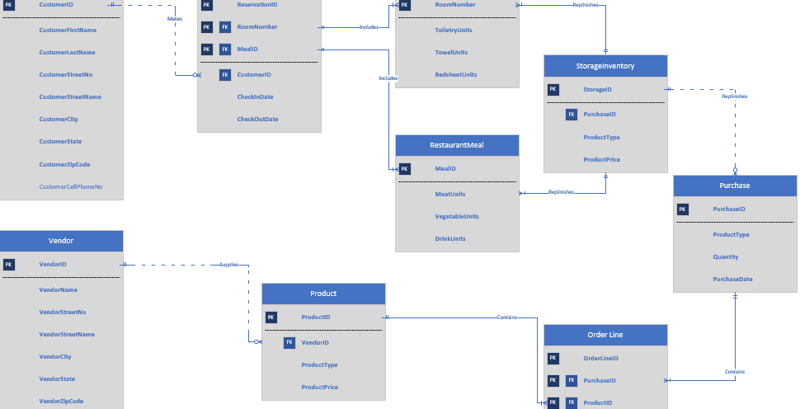

Slide 9
DEMO SLIDES

Slide 10
FORMS

Slide 11
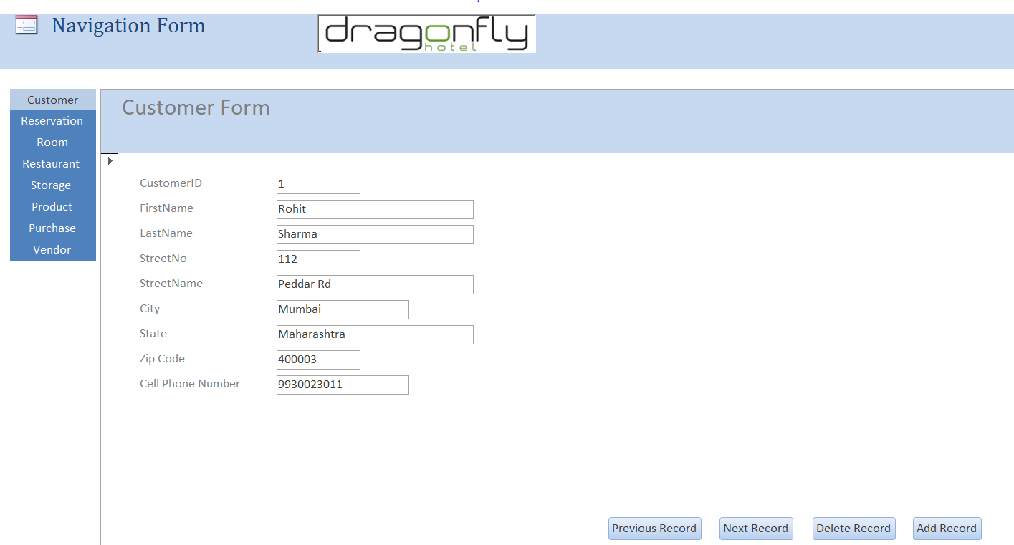

Slide 12
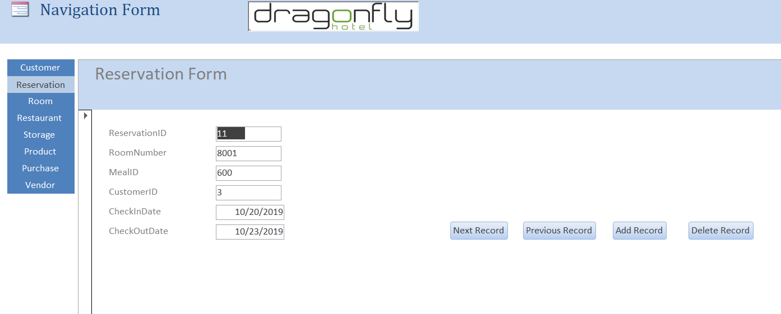

Slide 13
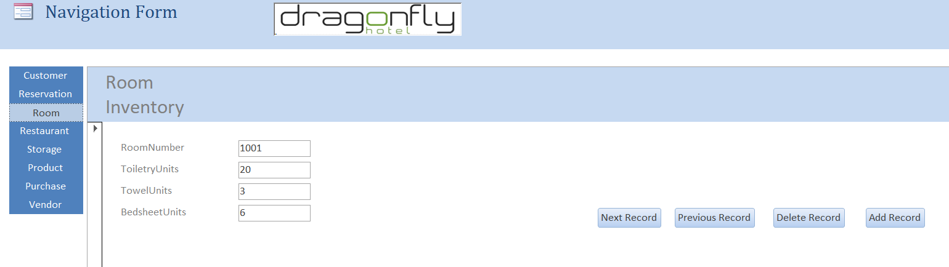

Slide 14
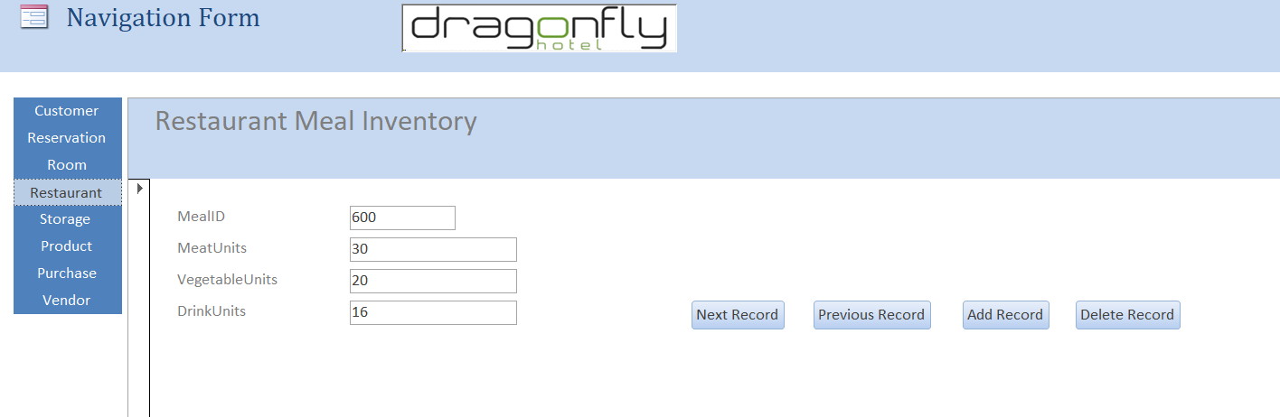

Slide 15
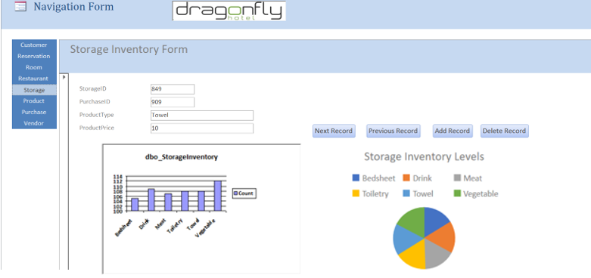

Slide 16
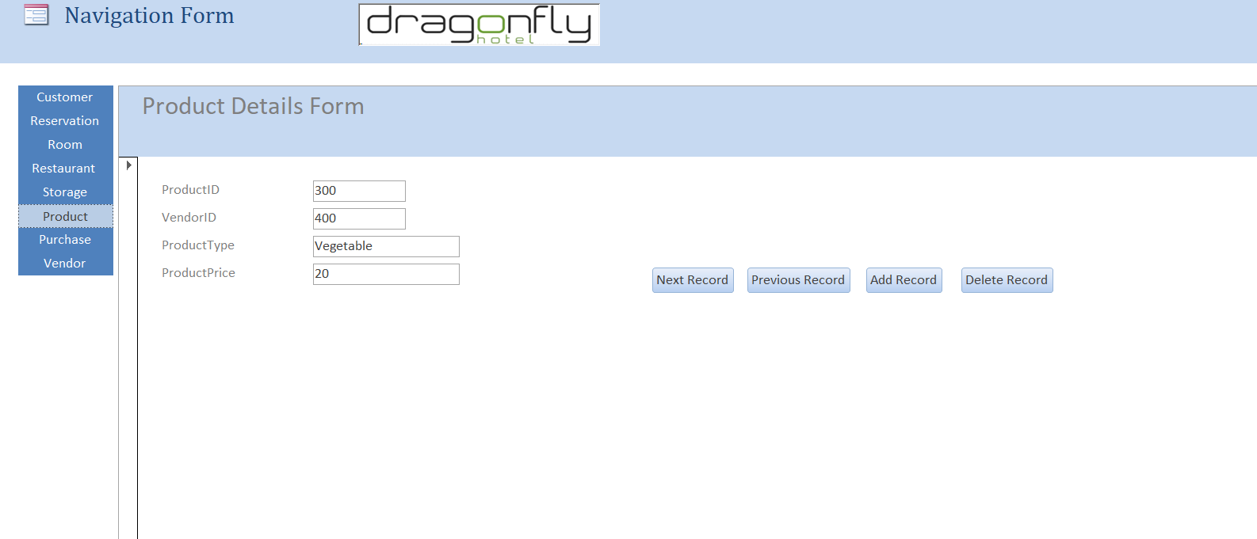

Slide 17
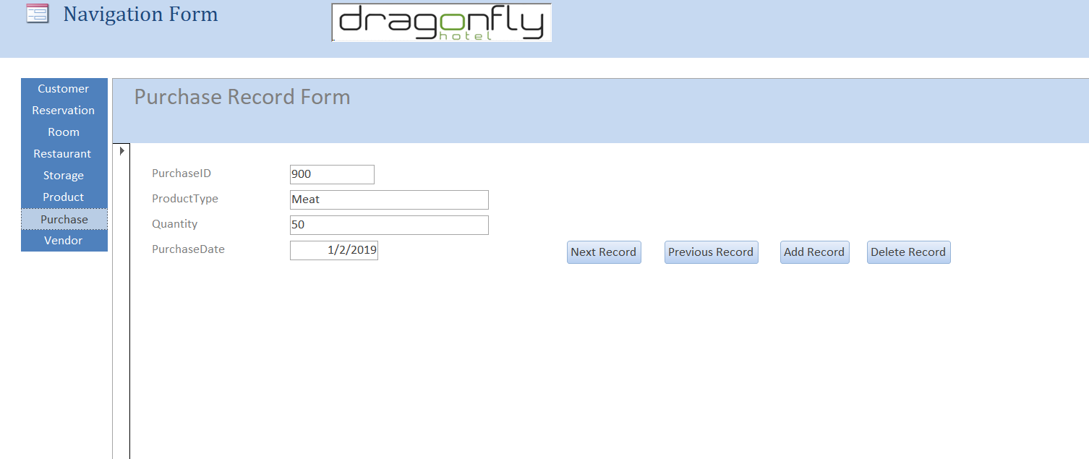

Slide 18
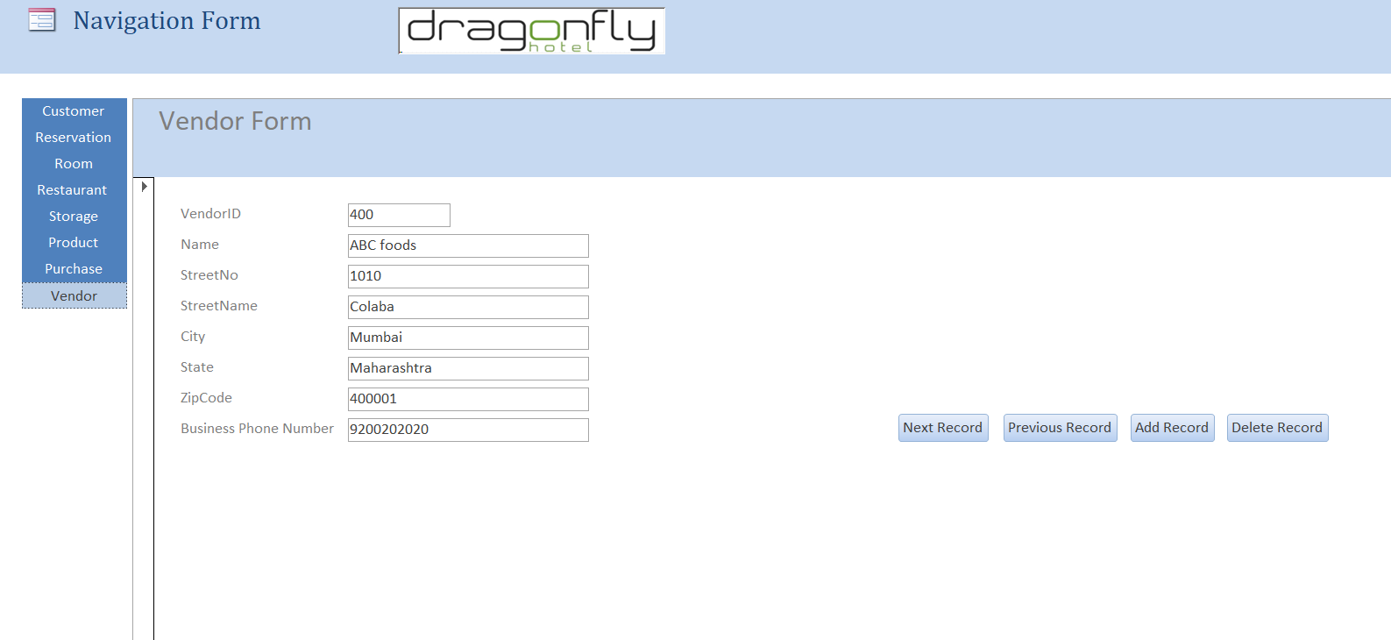

Slide 19
REPORTS

Slide 20
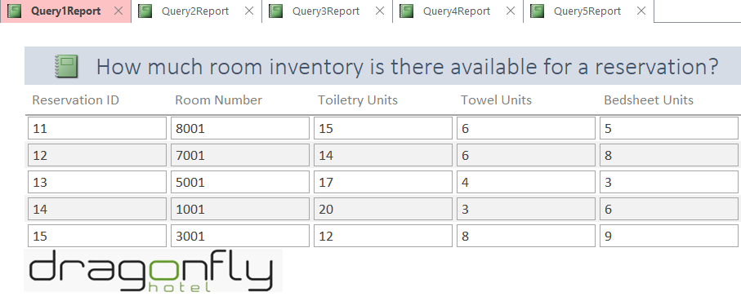

Slide 21
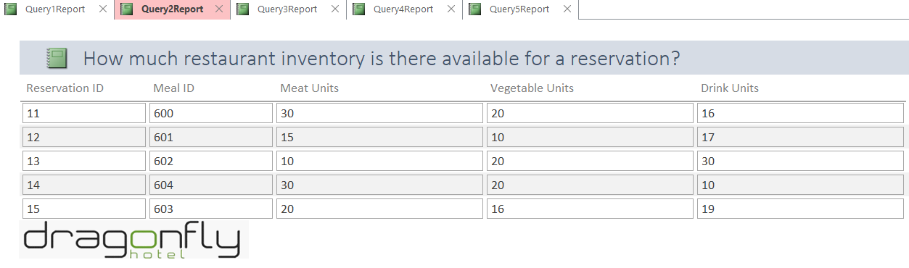

Slide 22
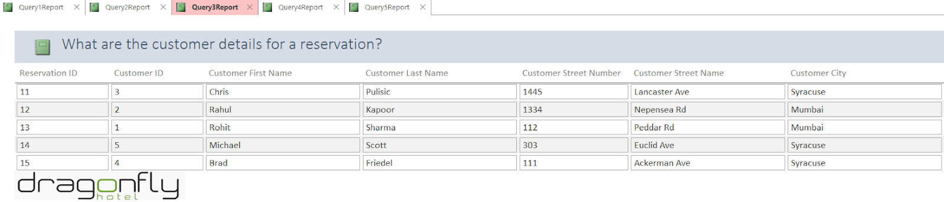
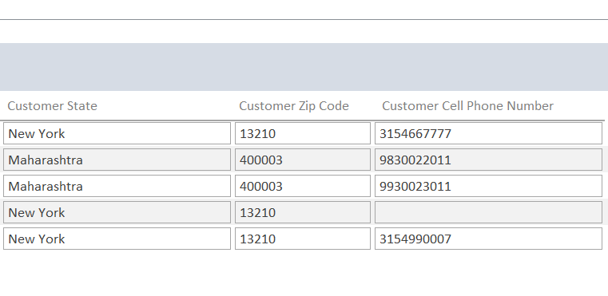

Slide 23
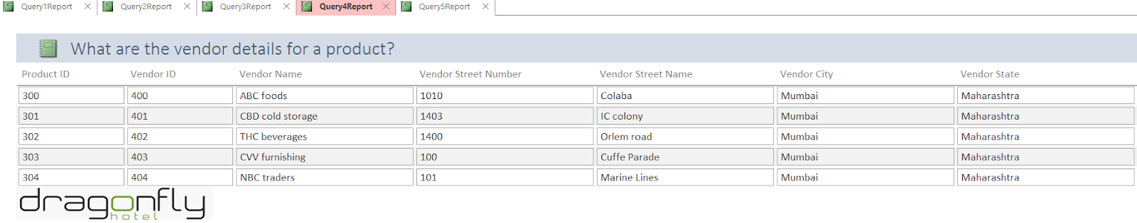
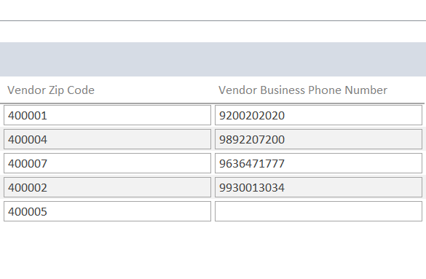

Slide 24
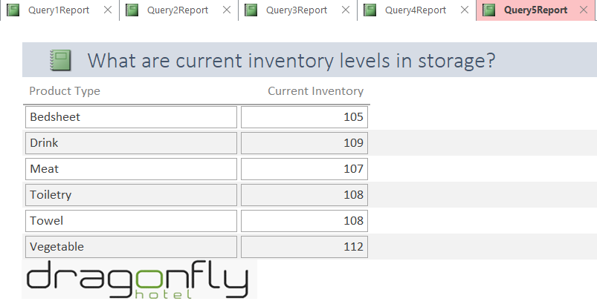

Slide 25
CONCLUSION
By shifting towards a database management system for their inventory, Hotel Dragonfly can eradicate several issues and get an accurate picture of the items left so that they can be replenished by the purchase manager by contacting their wholesaler.
The inventory levels could be tracked in real time by different stakeholders and accordingly help them in making relevant business decisions.
This will in turn aid in the pricing analysis of the hotel rooms and in maintaining a proper supply chain so that the inventory does not run out.
Our demo slides show how this new database management system can answer major data questions for the business with a robust, easy-to-use interface.

Slide 26
THANK YOU
Any questions?

